Slide 1

E-Commerce: Mechanisms, Platforms, and Tools

Slide 2
Learning Objectives
Describe the major electronic commerce (EC) activities and processes and the mechanisms that support them.
Define e-marketplaces and list their components.
List the major types of e-marketplaces and describe their features.
Describe electronic catalogs, search engines, and shopping carts.
Describe the major types of auctions and list their characteristics.
Copyright © 2012 Pearson Education, Inc. Publishing as Prentice Hall
2-<number>

Slide 3
Learning Objectives
Discuss the benefits and limitations of e-auctions.
Describe bartering and negotiating online.
Describe virtual communities.
List the major Web 2.0 tools and their use in EC.
Describe social networks as an EC mechanism.
Understand virtual worlds and their use in EC.
Describe Web 3.0 and define Web 4.0.
Copyright © 2012 Pearson Education, Inc. Publishing as Prentice Hall
2-<number>

Slide 4
Electronic Commerce Mechanisms: An Overview
EC ACTIVITIES AND SUPPORT MECHANISMS
The EC trading activities are divided into six categories
Each activity is supported by one or more EC mechanisms
Copyright © 2012 Pearson Education, Inc. Publishing as Prentice Hall
2-<number>

Slide 5
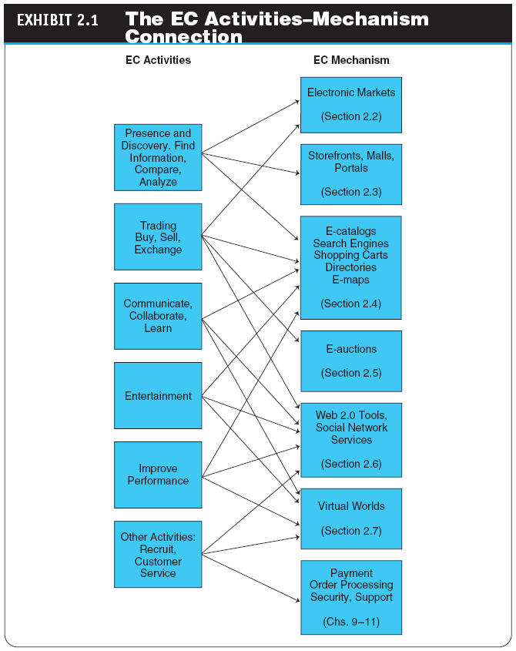
Copyright © 2012 Pearson Education, Inc. Publishing as Prentice Hall
2-<number>

Slide 6
Electronic Commerce Mechanisms: An Overview
SELLERS, BUYERS, AND TRANSACTIONS
a seller(retailer,wholesaler or manufacturer) sells to customers.
The seller buys from suppliers either raw materials (as a manufacturer) or components for assembly (as an assembler) ,or finished goods (as retailer).
Copyright © 2012 Pearson Education, Inc. Publishing as Prentice Hall
2-<number>

Slide 7
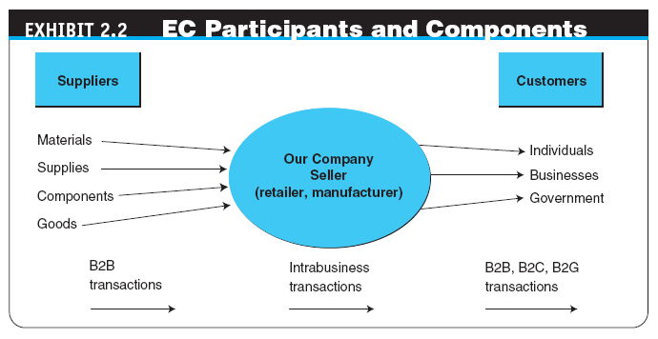
Copyright © 2012 Pearson Education, Inc. Publishing as Prentice Hall
2-<number>

Slide 8
Electronic Commerce Mechanisms: An Overview
  The Purchasing Process
  Customers buy goods online in different ways.
  The most common way is purchasing from catalogs at fixed prices.
  Some times prices may be negotiated or discounted.
  Another way to determine price is dynamic pricing, which refers to nonfixed prices such as those in stock markets.
Copyright © 2012 Pearson Education, Inc. Publishing as Prentice Hall
2-<number>

Slide 9
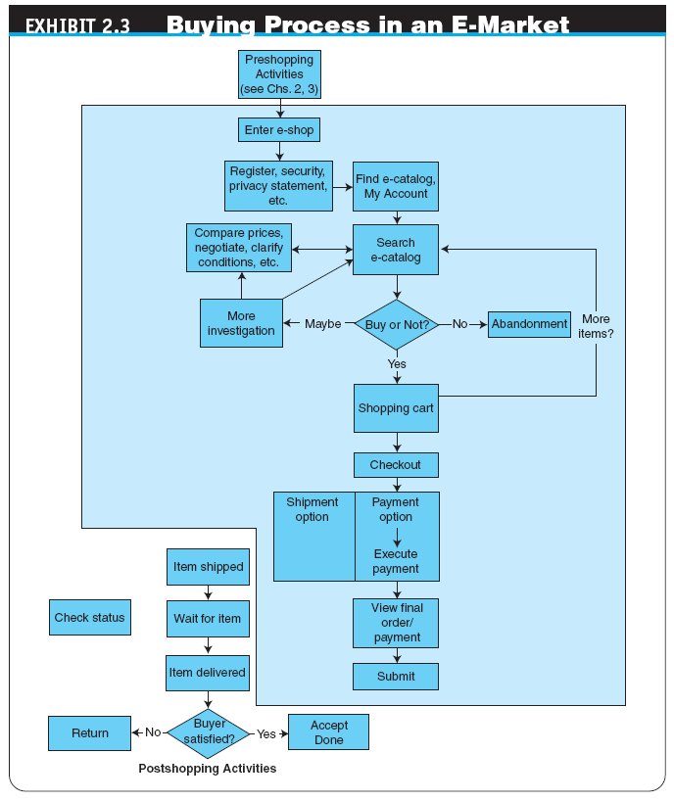
Copyright © 2012 Pearson Education, Inc. Publishing as Prentice Hall
2-<number>

Slide 10
E-Marketplaces
e-marketplace
An online market in which buyers and sellers exchange goods or services;
the three types of e-marketplaces are private, public, and consortia
marketspace
  A marketplace in which sellers and buyers exchange goods and services for money (or for other goods and services), but do so electronically
Copyright © 2012 Pearson Education, Inc. Publishing as Prentice Hall
2-<number>

Slide 11
E-Marketplaces
The major components and players in a marketplaces are:
  Customers
  Sellers
  Products and services
    digital products
    Goods that can be transformed to digital format and delivered over the Internet
  Infrastructure
electronic networks, databases, hardware, software, and more.
Copyright © 2012 Pearson Education, Inc. Publishing as Prentice Hall
2-<number>

Slide 12
E-Marketplaces
  front end
  The portion of an e-seller’s business processes through which customers interact, including the seller’s portal, electronic catalogs, a shopping cart, a search engine, and a payment gateway
  back end
  The activities that support online order fulfillment, inventory management, purchasing from suppliers, payment processing, packaging, and delivery
  intermediary
  A third party that operates between sellers and buyers
  Support services: such as security, Payment, certification, etc.
Copyright © 2012 Pearson Education, Inc. Publishing as Prentice Hall
2-<number>

Slide 13
E-Marketplaces
TYPES OF E-MARKETPLACES:
  Private E-Marketplaces: they are owned and operated by a single company
    sell-side e-marketplace
    A private e-marketplace in which one company sells either standard and/or customized products to individuals or companies. It is considered to be one-to-many
    buy-side e-marketplace
    A private e-marketplace in which one company makes purchases from many suppliers . It is considered to be many-to-one
Copyright © 2012 Pearson Education, Inc. Publishing as Prentice Hall
2-<number>

Slide 14
E-Marketplaces
    Public E-Marketplaces:
      They are owned by a third party (not a seller or a buyer) or by a group of selling and buying companies (a consortium)
      They serve many sellers and many buyers
      They are known as exchanges
Copyright © 2012 Pearson Education, Inc. Publishing as Prentice Hall
2-<number>

Slide 15
Customer Shopping Mechanisms: Webstores, Malls, and Portals
Webstore (storefront)
A single company’s website where products or services are sold;
  Several mechanisms are included in a Webfront:
    Electronic catalog
    Search engine
    Electronic cart
    E-auction facilities
    Payment gateway
    Shipment court
    Customer services
Copyright © 2012 Pearson Education, Inc. Publishing as Prentice Hall
2-<number>

Slide 16
Customer Shopping Mechanisms: Storefronts, Malls, and Portals
e-mall (online mall)
An online shopping center where many online stores are located
TYPES OF STORES AND MALLS
  General stores/malls
  Specialized stores/malls
  Regional versus global stores
  Pure-play versus click-and-mortar stores
Copyright © 2012 Pearson Education, Inc. Publishing as Prentice Hall
2-<number>

Slide 17
Customer Shopping Mechanisms: Storefronts, Malls, and Portals
Web (information) portal
A single point of access, through a Web browser, to critical business information located inside and outside (via Internet) an organization
  Types of Portals
    Commercial (public) portals
    Corporate portals
    Publishing portals
    Personal portals
    mobile portal
    A portal accessible via a mobile device.
    voice portal
    A portal accessed by telephone or cell phone.
Copyright © 2012 Pearson Education, Inc. Publishing as Prentice Hall
2-<number>

Slide 18
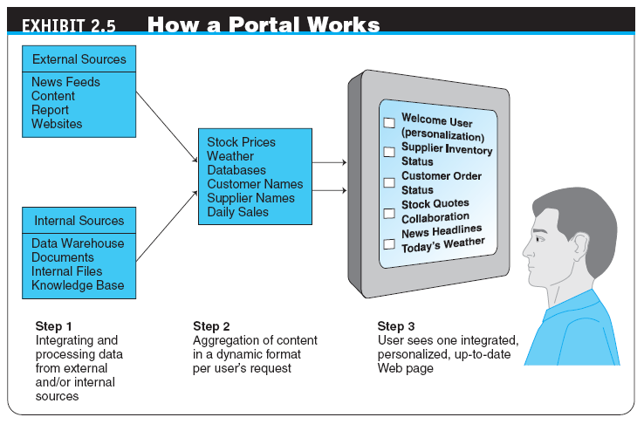
Copyright © 2012 Pearson Education, Inc. Publishing as Prentice Hall
2-<number>

Slide 19
Customer Shopping Mechanisms: Storefronts, Malls, and Portals
THE ROLES AND VALUE OF INTERMEDIARIES IN E-MARKETPLACES
  Intermediaries, such as brokers, play an important role in commerce by providing value-added activities and services to buyers and sellers.
  The two major types of online intermediaries are brokers and infomediaries.
Copyright © 2012 Pearson Education, Inc. Publishing as Prentice Hall
2-<number>

Slide 20
Customer Shopping Mechanisms: Storefronts, Malls, and Portals
  Brokers
    A broker in EC is a person or a company that facilitates transactions between buyers and sellers.
    The following are different types of brokers:
      Trading
      Organization of online malls
      Comparison agent.
      Shopping aids provider
      Matching services
Copyright © 2012 Pearson Education, Inc. Publishing as Prentice Hall
2-<number>

Slide 21
Customer Shopping Mechanisms: Storefronts, Malls, and Portals
  infomediaries
  Electronic intermediaries that provide and/or control information flow in cyberspace, often aggregating information and selling it to others
  Distributors in B2B
A special type of intermediary in e-commerce is the B2B e-distributor
  e-distributor
  An e-commerce intermediary that connects manufacturers with business buyers (customers) by aggregating the catalogs of many manufacturers in one place—the intermediary’s website
Copyright © 2012 Pearson Education, Inc. Publishing as Prentice Hall
2-<number>

Slide 22
Merchant Solutions: Electronic Catalogs, Search Engines, and Shopping Carts
electronic catalogs (e-catalogs)
The presentation of product information in an electronic form; the backbone of most e-selling sites
  Online Catalogs Versus Paper Catalogs
Copyright © 2012 Pearson Education, Inc. Publishing as Prentice Hall
2-<number>

Slide 23
Merchant Solutions: Electronic Catalogs, Search Engines, and Shopping Carts
EC SEARCH ACTIVITIES, TYPES, AND ENGINES
  Types of EC Searches
    Internet/Web Search
    enterprise search
    The practice of identifying and enabling specific content across the enterprise to be indexed, searched, and displayed to authorized users
Copyright © 2012 Pearson Education, Inc. Publishing as Prentice Hall
2-<number>

Slide 24
Merchant Solutions: Electronic Catalogs, Search Engines, and Shopping Carts
    desktop search
    Search tools that search the contents of a user’s or organization’s computer files, rather than searching the Internet
    The emphasis is on finding all the information that is available on the user’s PC, including Web browser histories, e-mail archives, and word-processed documents, as well as in all internal files and databases.
Copyright © 2012 Pearson Education, Inc. Publishing as Prentice Hall
2-<number>

Slide 25
Merchant Solutions: Electronic Catalogs, Search Engines, and Shopping Carts
  search engine
  A computer program that can access databases of Internet resources, search for specific information or key words, and report the results
  Software (Intelligent) Agents
  Questions and Answers Online
  Voice-Powered Search
  Visual Shopping Search Engine
  Video and Mobile Search
  Social Network Search Engines
Copyright © 2012 Pearson Education, Inc. Publishing as Prentice Hall
2-<number>

Slide 26
Merchant Solutions: Electronic Catalogs, Search Engines, and Shopping Carts
electronic shopping cart
An order-processing technology that allows customers to accumulate items they wish to buy while they continue to shop
Copyright © 2012 Pearson Education, Inc. Publishing as Prentice Hall
2-<number>

Slide 27
Auctions, Bartering, and Negotiating Online
auction
A competitive process in which a seller solicits consecutive bids from buyers (forward auctions) or a buyer solicits bids from sellers (backward auctions); prices are determined dynamically by the bids
dynamic pricing
Prices that change based on supply and demand relationships at any given time
Copyright © 2012 Pearson Education, Inc. Publishing as Prentice Hall
2-<number>

Slide 28
Auctions, Bartering, and Negotiating Online
TRADITIONAL AUCTIONS VERSUS E-AUCTIONS
  Limitations of Traditional Offline Auctions
  electronic auctions (e-auctions)
  Auctions conducted online
Copyright © 2012 Pearson Education, Inc. Publishing as Prentice Hall
2-<number>

Slide 29
Auctions, Bartering, and Negotiating Online
TYPES OF AUCTIONS
  One Buyer, One Seller
  One Seller, Many Potential Buyers
    forward auction
    An auction in which a seller entertains bids from buyers; bidders increase price sequentially
Copyright © 2012 Pearson Education, Inc. Publishing as Prentice Hall
2-<number>

Slide 30
Auctions, Bartering, and Negotiating Online
  One Buyer, Many Potential Sellers
    reverse auction (bidding or tendering system)
    Auction in which the buyer places an item for bid (tender) on a request for quote (RFQ) system, potential suppliers bid on the job, with the price reducing sequentially, and the lowest bid wins; primarily a B2B or G2B mechanism
    name-your-own-price model
    Auction model in which a would-be buyer specifies the price (and other terms) he or she is willing to pay to any willing and able seller; a C2B model that was pioneered by Priceline.com.
Copyright © 2012 Pearson Education, Inc. Publishing as Prentice Hall
2-<number>

Slide 31
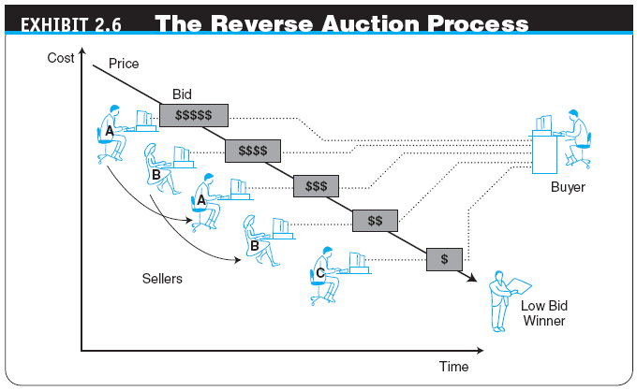
Copyright © 2012 Pearson Education, Inc. Publishing as Prentice Hall
2-<number>

Slide 32
Auctions, Bartering, and Negotiating Online
  Many Sellers, Many Buyers
    double auction
    An auction in which multiple buyers and their bidding prices are matched with multiple sellers and their asking prices, considering the quantities on both sides
  penny auction
  A formal auction in which participants pay a nonrefundable small fee for each bid; bid level changes by small increments
Copyright © 2012 Pearson Education, Inc. Publishing as Prentice Hall
2-<number>

Slide 33
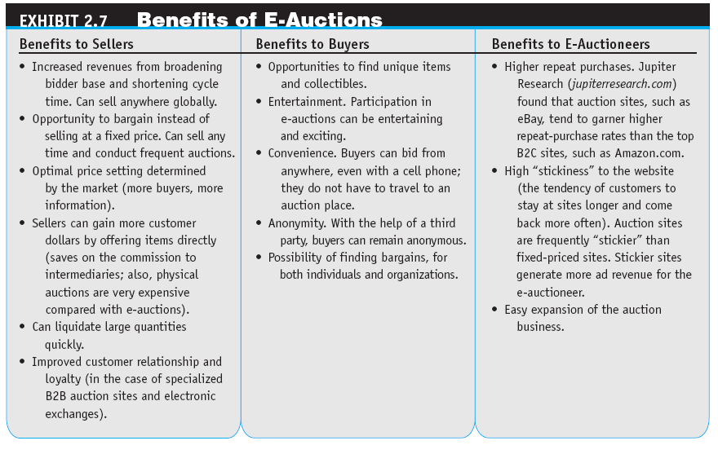
Copyright © 2012 Pearson Education, Inc. Publishing as Prentice Hall
2-<number>

Slide 34
Auctions, Bartering, and Negotiating Online
Limitations of E-Auctions
  Minimal Security
  Possibility of Fraud
  Limited Participation
Copyright © 2012 Pearson Education, Inc. Publishing as Prentice Hall
2-<number>

Slide 35
Auctions, Bartering, and Negotiating Online
IMPACTS OF AUCTIONS
  The following are some representative impacts of e-auctions.
    Auctions as a Social Mechanism to Determine a Price
    Auctions as a Highly Visible Distribution Mechanism
    Auctions as an EC Component in a Business Model
    Auctions for Profit for Individuals
Copyright © 2012 Pearson Education, Inc. Publishing as Prentice Hall
2-<number>

Slide 36
Auctions, Bartering, and Negotiating Online
ONLINE BARTERING
  bartering
  The exchange of goods and services
  e-bartering (electronic bartering)
  Bartering conducted online, usually in a bartering exchange
  bartering exchange
  A marketplace in which an intermediary arranges barter transactions
ONLINE NEGOTIATING
Copyright © 2012 Pearson Education, Inc. Publishing as Prentice Hall
2-<number>

Slide 37
Social Software Tools:
From Blogs to Wikis to Twitter
social software
A software product that enables people to rendezvous, engageconnect, and collaborate through computer-mediated communication e.g facebook,Flickr,youtube,amazon.com,eBay
blog
A personal website that is open to the public to read and to interact with; dedicated to specific topics or issues in which owner expresses his or her feeling or opinions. Blogs can result in two way communication and collaboration, group discussions and so on.
  vlog (or video blog)
  A blog with video content
Copyright © 2012 Pearson Education, Inc. Publishing as Prentice Hall
2-<number>

Slide 38
Social Software Tools:
From Blogs to Wikis to Twitter
  Building Effective Blogs:
    It is becoming easier to build blogs.
    Programs from blogger.com are very user –friendly.
    Blog space is free.
    Bloggers(the people who create and maintain blogs) are handed a fresh space on their website to write in each day.
    They can easily edit, add ,entries and broadcast whatever they want by simply clicking “send”.
  Commercial Uses of Blogs
    The blog concept has transferred to the commercial world
  Potential Risks of Corporate Blogs
    some people see risk in commercial blogging.
Copyright © 2012 Pearson Education, Inc. Publishing as Prentice Hall
2-<number>

Slide 39
Social Software Tools:
From Blogs to Wikis to Twitter
microblogging
A form of blogging that allows users to write messages (usually up to 140 characters) and publish them, either to be viewed by anyone or by a restricted group that can be chosen by the user; these messages can be submitted by a variety of means, including text messaging, instant messaging, e-mail, MP3, or just on the Web
Twitter
A free microblogging service that allows its users to send and read other users’ updates
Copyright © 2012 Pearson Education, Inc. Publishing as Prentice Hall
2-<number>

Slide 40
Social Software Tools:
From Blogs to Wikis to Twitter
  tweets
  Text-based posts up to 140 characters in length posted to Twitter
  The Essentials of Twitter for Business
    The Major Benefits of Twitter
    Examples of Twitter as Enterprise Tools
Copyright © 2012 Pearson Education, Inc. Publishing as Prentice Hall
2-<number>

Slide 41
Social Software Tools:
From Blogs to Wikis to Twitter
wiki (wikilog)
A blog that allows everyone to participate as a peer; anyone may add, delete, or change content
  Business Applications of Wikis
Copyright © 2012 Pearson Education, Inc. Publishing as Prentice Hall
2-<number>

Slide 42
Social Software Tools:
From Blogs to Wikis to Twitter
MECHANISM AIDS FOR WEB 2.0 TOOLS: TAGS, FOLKSONOMY, MASHUPS, AND SOCIAL BOOKMARKS
  tag
  A nonhierarchical key word or term assigned to a piece of information (such as an Internet bookmark, digital image, video clip, or any computer document)
  folksonomy (collaborative tagging, social tagging)
  The practice and method of collaboratively creating, classifying, and managing tags to annotate and categorize content
Copyright © 2012 Pearson Education, Inc. Publishing as Prentice Hall
2-<number>

Slide 43
Social Software Tools:
From Blogs to Wikis to Twitter
  mashup
  Combination of two or more websites into a single website that provides the content of both sites (whole or partial) to deliver a novel product to consumers
  social bookmarking
  Web service for sharing Internet bookmarks; the sites are a popular way to store, classify, share, and search links through the practice of folksonomy techniques on the Internet and intranets
Copyright © 2012 Pearson Education, Inc. Publishing as Prentice Hall
2-<number>

Slide 44
Virtual Communities and Social Networks
virtual community
A group of people with similar interests who interact with one another using the Internet
The interaction takes place over a computer network, mainly the internet.
virtual communities parallel typical physical communities,such as neighborhood,clubs,or associations,but people do not meet face to face.
Istead ,they meet online.
It is a social network organized around a common interest , idea,task,or goal , members interact across time , geographic , and organizational boundaries to develop personal relationships.
Copyright © 2012 Pearson Education, Inc. Publishing as Prentice Hall
2-<number>

Slide 45
Virtual Communities and Social Networks
virtual communities offer several ways for members to interact,collaborate,and trade.
Most virtual communities are internet-based known as Internet communities.
Hundreds of thousands of communities exist on the internet, and the number is growing rapidly.
Types of virtual Communities
Copyright © 2012 Pearson Education, Inc. Publishing as Prentice Hall
2-<number>

Slide 46
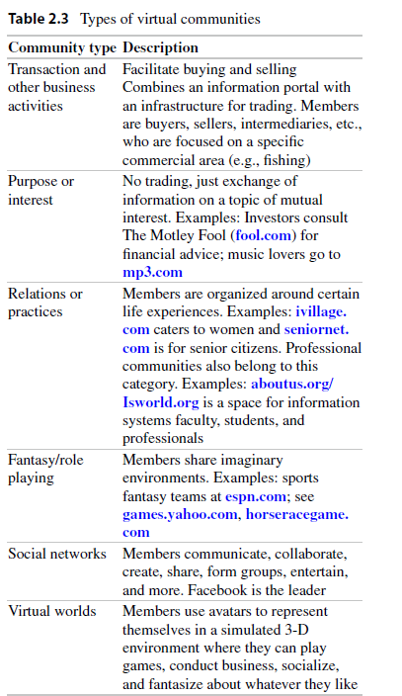
2-<number>

Slide 47
Virtual Communities and Social Networks
  Other Classifications of Virtual Communities
      Public Versus Private Communities
    Public communities
      their membership is open to anyone.
      The owner of the community may be a privately held corporation or a public one.
      .e.g facebook belong to public category
    Private communities
      belong each to a company, an association or a group of companies and their membership is limited to people who meet certain requirement.
      e.g (work for a particular employer or work in a particular profession).
      Private communities may be internal (e.g only employees can be members) or external(for customers)
2-<number>

Slide 48
Virtual Communities and Social Networks
    Classification Categories
      Another option is to classify the members as traders, players, just friends, or friends in need.
Copyright © 2012 Pearson Education, Inc. Publishing as Prentice Hall
2-<number>

Slide 49
Virtual Communities and Social Networks
ONLINE SOCIAL NETWORKS
  Social networks is a place where people create their own space, or homepage, on which they write blog; post picture, videos, music, share ideas, link other web locations, can tag the content they create and post it with key words.
  The Size of Social Network Sites
  Social network sites are growing rapidly,with some having over 100 million members.e.g facebook had 750 million members in june 2011.
  A Global Phenomenon
  Although facebook and MySpace attract the majority of media attention in the United states, they do have many members in other countries.other social network sites area proliferating and growing in popularity worldwide.
Copyright © 2012 Pearson Education, Inc. Publishing as Prentice Hall
2-<number>

Slide 50
Virtual Communities and Social Networks
  Representative Capabilities and Services Provided by Social Network Sites
  Social network sites provide many capabilities and services such as
    create a circle of friends,
    discussion forums,
    share photo,video,documents,etc,
    construct a Web page
    Messages
Copyright © 2012 Pearson Education, Inc. Publishing as Prentice Hall
2-<number>

Slide 51
Virtual Communities and Social Networks
business-oriented social networks
A social network whose major interest is business topics and whose members are professional people; such networks are used mostly for creating contacts, providing requirements, and enlisting members’ support for problem solving and knowledge sharing
Examples: linkedIn
Copyright © 2012 Pearson Education, Inc. Publishing as Prentice Hall
2-<number>

Slide 52
Virtual Communities and Social Networks
  Example of a Business-Oriented Social Network
  User can visit the business-oriented social network websites to
    establish new business contacts,
    expand and manage their contact’s networks,
    identify experts and receive advice,
    organize meetings and events.
  Some Capabilities of Business-Oriented Networks
  By using these websites company can
    encourage consumers to rate and comment of products,
    allow consumers to create their own topic areas and build communities and shared interest related to a company’s products.
  Business Models and Services Related to Social Networking
  Social networking sites provide innovative business models,ranging from customer reviews of food and night life in India to users who dress up dolls that look like celebrities.
2-<number>

Slide 53
Virtual Communities and Social Networks
  Social Network Analysis Software
    These software is used to identify, represent, analyze, visualize network nodes (e.g agents, organizations or knowledge)
  Xanga
    Xanga.com host blogs, photoblogs and social networking profiles.
  Digg
    Digg.com is a community based website with an emphasis on technology and science articles.
Copyright © 2012 Pearson Education, Inc. Publishing as Prentice Hall
2-<number>

Slide 54
Virtual Communities and Social Networks
Mobile Social Commerce
    It is growing faster than any other type of EC computing
    According to The Retail Bulletin ( 2012 ), 64% smartphone consumers used them to shop online
mobile social networking
  It refers to social networking where members chat and connect with one another using any mobile device
Copyright © 2012 Pearson Education, Inc. Publishing as Prentice Hall
2-<number>

Slide 55
Virtual Communities and Social Networks
Recent Innovative Tools and Platforms for Social Networking:
  Snapchat.com
  Whatsapp.com
  Instagram.com
  Etc.
Copyright © 2012 Pearson Education, Inc. Publishing as Prentice Hall
2-<number>

Slide 56
Virtual Communities and Social Networks
Mobile Community Activities
  Users can use their mobile devices to
    create their profiles,
    make friends participate in chat rooms,
    create chat rooms,
    hold private conversations,
    share photos,videos and blogs.
SOCIAL NETWORK SERVICES
Social network services are companies that host social communities.
They are known in brief as social networks.
social-oriented networks are Facebook and MySpace.
LinkedIn is a business-oriented network.
Copyright © 2012 Pearson Education, Inc. Publishing as Prentice Hall
2-<number>

Slide 57
Virtual Worlds as an
Electronic Commerce Platforms
virtual world
A user-defined world in which people can interact, play, and do business; the most publicized virtual world is Second Life
Virtual worlds are not limited to games.
Players can create a character to travel between buildings, towns, and even worlds to carry out business or leisure (free , holdidays) activities.
Avatars
  Virtual worlds are populated with interactive animated characters—software agents known as Avatars.
Copyright © 2012 Pearson Education, Inc. Publishing as Prentice Hall
2-<number>

Slide 58
Virtual Worlds as an
Electronic Commerce Platforms
Avatars are animated computer characters that exhibit humanlike movements and behaviors
Advanced avatars can “speak” and display behaviors such as gestures and facial expressions.
They can be fuly automated to act like robots.
Many companies use avatars as tour guides or to staff virtual reception desks.
Avatars are aimed at making the human-computer interface more natural.
Copyright © 2012 Pearson Education, Inc. Publishing as Prentice Hall
2-<number>

Slide 59
Virtual Worlds as an
Electronic Commerce Mechanism
BUSINESS ACTIVITIES AND VALUE IN VIRTUAL WORLDS
There are several types of business activities in virtual worlds.
  Creating and managing a virtual business
  Conducting regular business activities
  Providing services for those who build, manage, or make money with virtual properties.
Examples of how companies use virtual worlds in businesses:
    Market Research
    guide and advise passengers in airports
2-<number>

Slide 60
Virtual Worlds as an
Electronic Commerce Mechanism
  Virtual Shopping
    You go shopping with friends even while you remain miles apart.
    In reality, you are all at your computer terminal, but on the screen you would be transported to a digital replica of the shopping center
    As you walk at a virtual jeans store, web cameras in the real store let you see how crowded in actually is, your avatar ,set to your body’s measurements, tries on the jeans. you might buy things online or visit the physical store later.
  Trading Virtual Properties
    Trading virtual properties is a very popular activity in second life.
    haboo.com sells more virtual furniture worldwide
    the furniture is designed by teens on the site who decorate their rooms with furniture.
    The kids are buying not only furniture but also clothes, bags etc.
Copyright © 2012 Pearson Education, Inc. Publishing as Prentice Hall
2-<number>

Slide 61
EMERGING EC PLATFORMS:
AUGMENTED REALITY AND CROWDSOURCING
Augmented Reality
  Augmented reality is “a live, copy, view of a physical, real-world environment whose elements are augmented(or supplemented) by computer-generated sensory input such as sound, video, graphics or GPS data”.
  The computerized layer can be seen through an application on mobile devices such as smartphones, webcams, or 3D glasses (including 3D TV)
Crowdsourcing
  Another platform for e-commerce is crowdsourcing.
  The term crowd refers to any group of people such as a group of consumers, employees of a corporation, or members of a social network who offer expertise.
  A Crowd is frequently referred to a large group.
  Crowdsourcing utilizes crowds to collectively execute tasks such as solving problems, innovating, or getting large projects completed by dividing the work among many people.
Benefits of Crowdsourcing
2-<number>

Slide 62

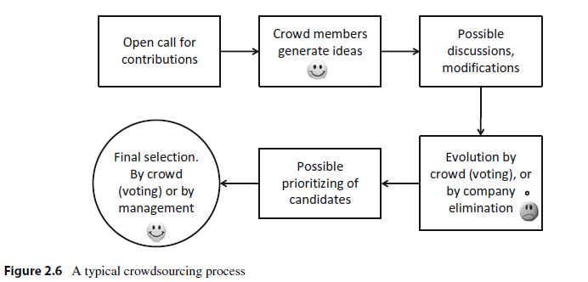
Copyright © 2012 Pearson Education, Inc. Publishing as Prentice Hall
2-<number>

Slide 63
The Future: Web 3.0 and Web 4.0
Web 3.0
  A term used to describe the future of the World Wide Web;
  is projected to deliver a new generation of business applications that will see business and social computing converge
  Web 3.0 could change the manner in which people live and work as well as the organizations where they work, and it may even revolutionize social networking
Web 3.0 and Semantic Web
An evolving extension of the Web in which Web content can be expressed not only in natural language, but also in a form that can be understood, interpreted, and used by intelligent computer software agents, permitting them to find, share, and integrate information more easily
Copyright © 2012 Pearson Education, Inc. Publishing as Prentice Hall
2-<number>

Slide 64
The Future: Web 3.0 and Web 4.0
Web 4.0
The Web generation after Web 3.0 that is still an unknown entity; however, it is envisioned as being based on islands of intelligence and as being ubiquitous
Copyright © 2012 Pearson Education, Inc. Publishing as Prentice Hall
2-<number>

Slide 65
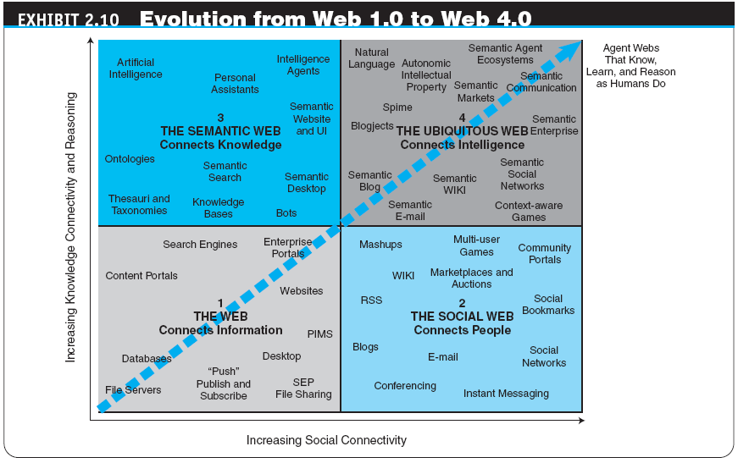
Copyright © 2012 Pearson Education, Inc. Publishing as Prentice Hall
2-<number>

Slide 66
Managerial Issues
Should we use auctions for selling?
Should we barter?
How do we select merchant software?
How can we use Facebook and other social networks in our business?
How shall we start using Web 2.0 tools?
Shall we take part in virtual worlds?
How should we deal with Web 2.0 risks?
Copyright © 2012 Pearson Education, Inc. Publishing as Prentice Hall
2-<number>

Slide 67
Summary
Activities and mechanisms
E-marketplaces and their components
The major types of e-marketplaces
Electronic catalogs, search engines, and shopping carts
Types of auctions and their characteristics
The benefits and limitations of auctions
Copyright © 2012 Pearson Education, Inc. Publishing as Prentice Hall
2-<number>

Slide 68
Summary
Bartering and negotiating
The structure and role of virtual communities
Web 2.0 tools
Social networks as an EC mechanism
Virtual worlds
Web 3.0 and Web 4.0
Copyright © 2012 Pearson Education, Inc. Publishing as Prentice Hall
2-<number>

